Slide 1
Explainable AI
Dr. Muhammad Shahzad

Slide 2
What is the problem?
Artificial intelligence and machine learning (AI/ML) systems have exceeded human performance in nearly every application where they have been tried
AI is starting to be incorporated into consumer products. This trend is accelerating, and AI will be increasingly used in safety-critical systems
AI systems are good, but sometimes make mistakes, and human users will not trust their decisions without explanation
There is a tradeoff between AI accuracy and explainability: the most accurate methods, such as convolutional neural nets (CNNs), provide no explanations; understandable methods, such as rule-based, tend to be less accurate

Slide 3
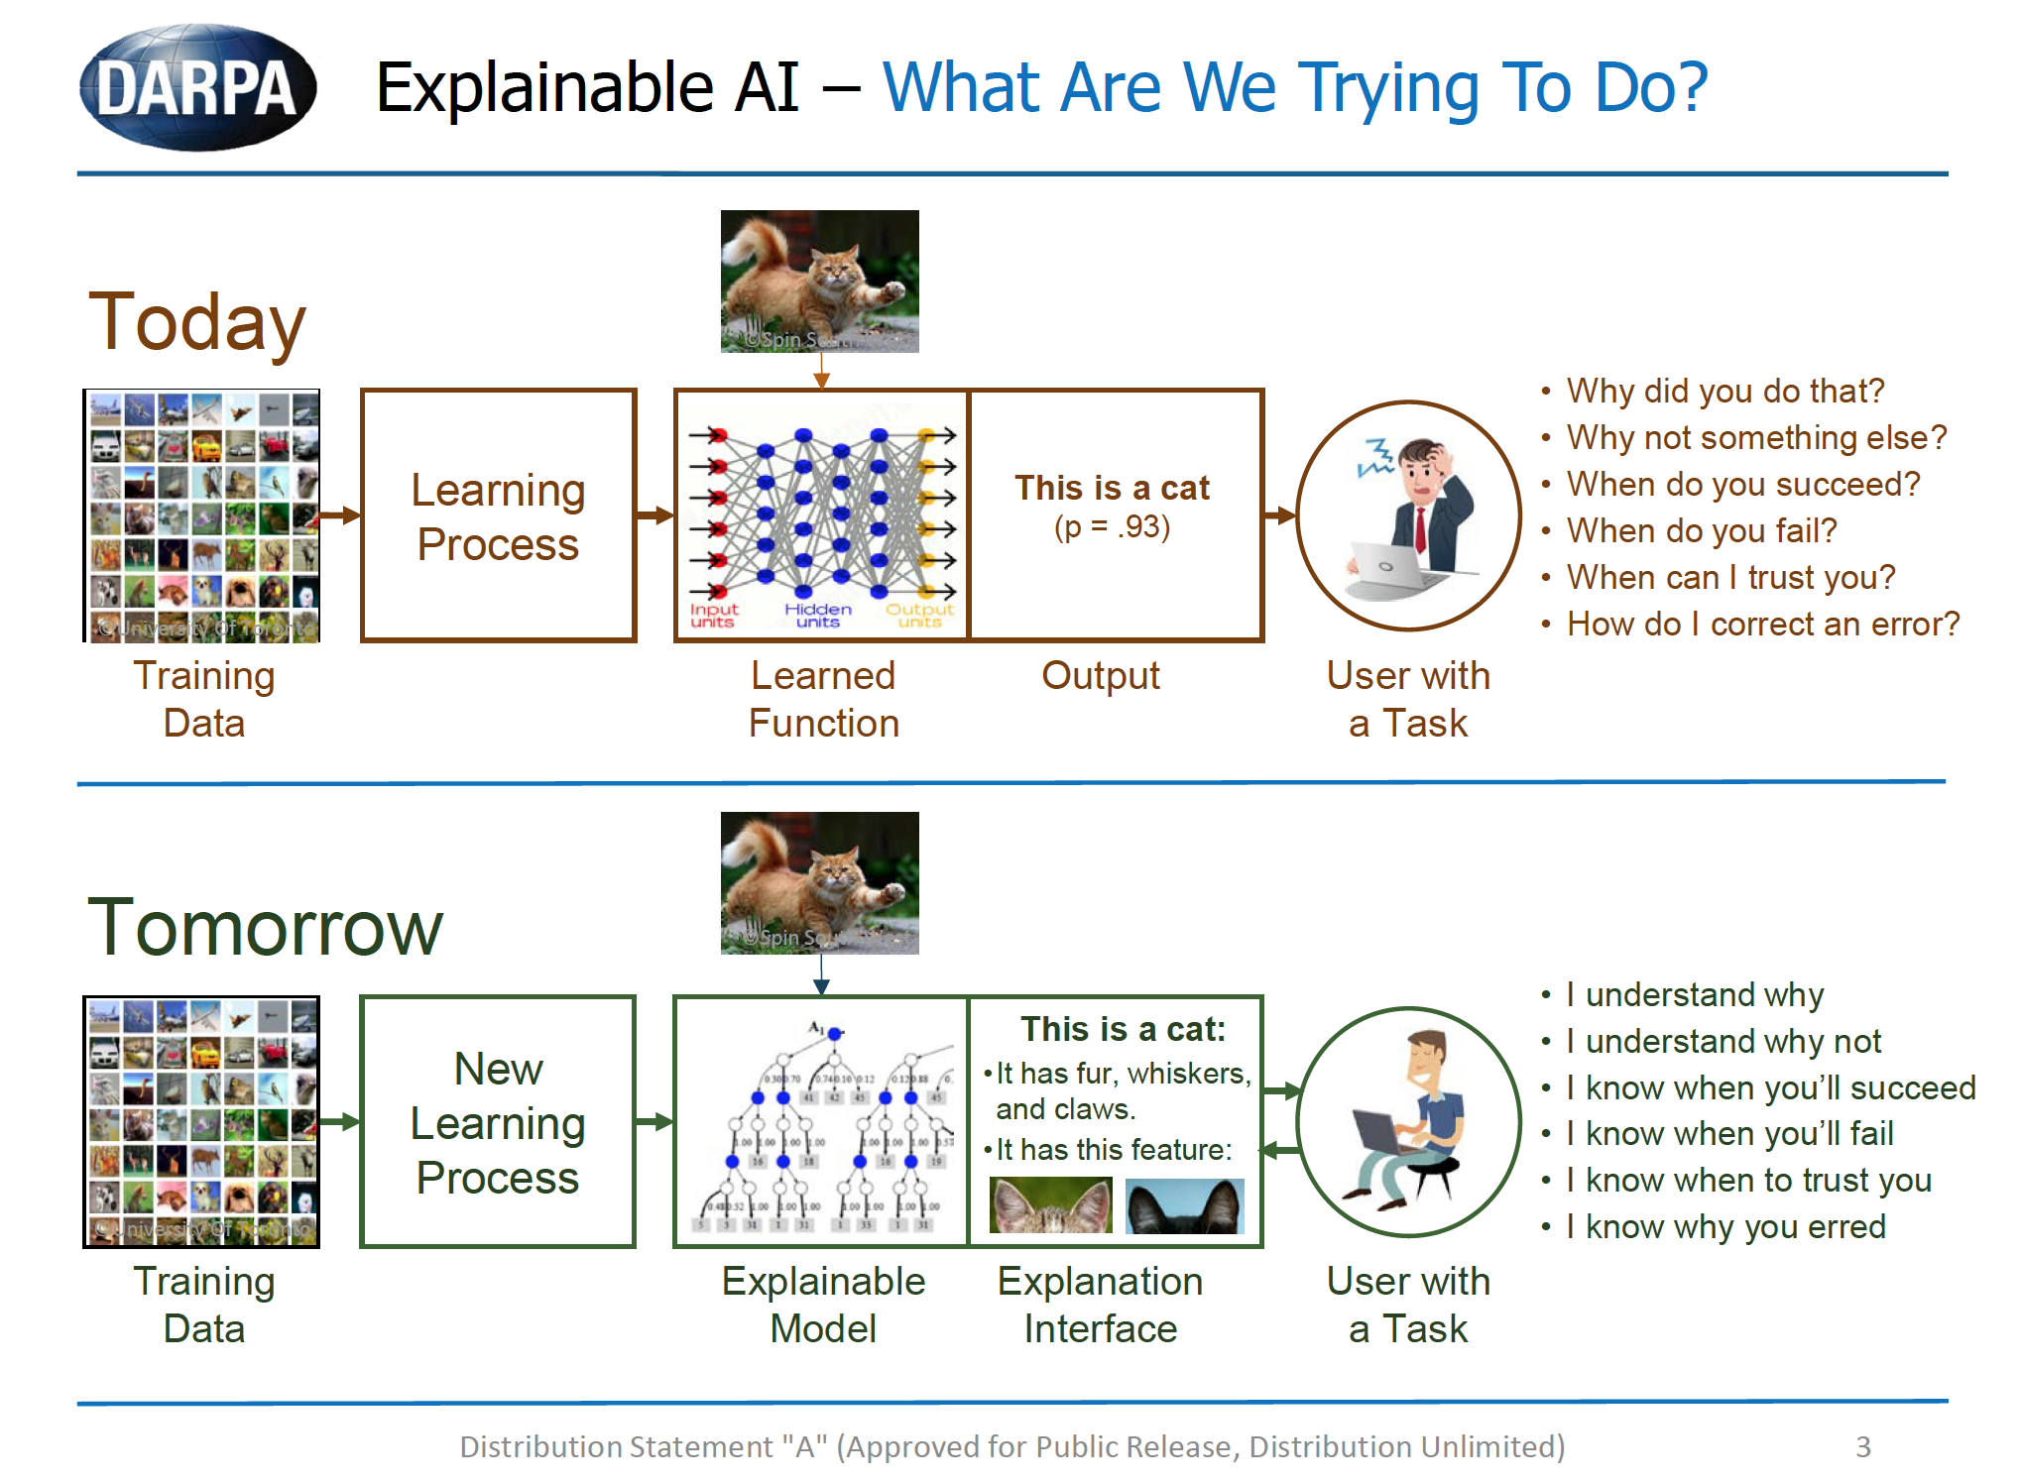
What is the current state of the art?
Black-box statistical predictions are inadequate
Explanations must be understandable to non-specialist

Slide 4
Tradeoff:
Expert system:
Good for explanations,
not so good for accuracy
- OR -
Neural nets:
Good for accuracy,
not so good for explanations
How do we get the
best of both worlds?

Slide 5
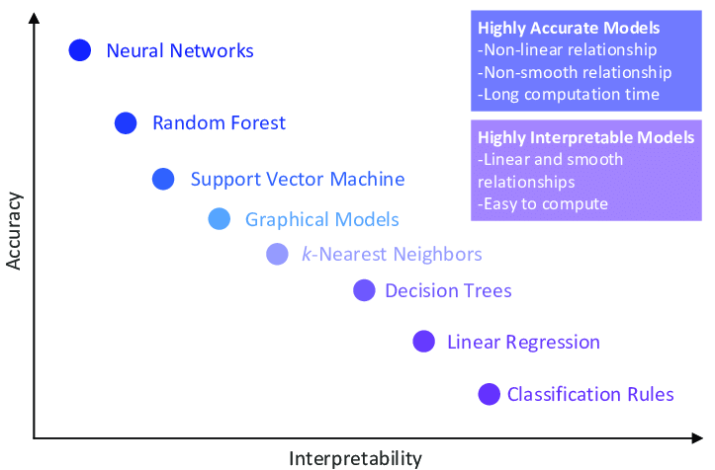
Interpretability Vs. Accuracy

Slide 6
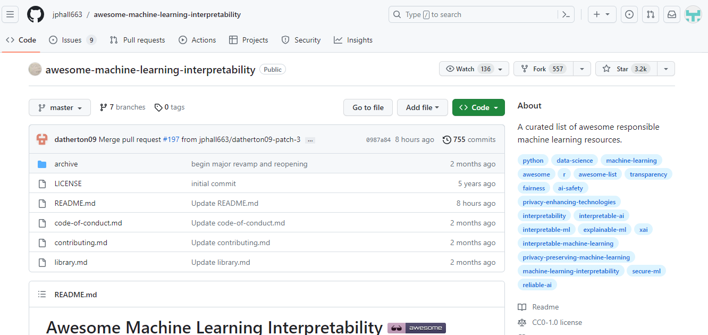
Good Repository
https://github.com/jphall663/awesome-machine-learning-interpretability

Slide 7
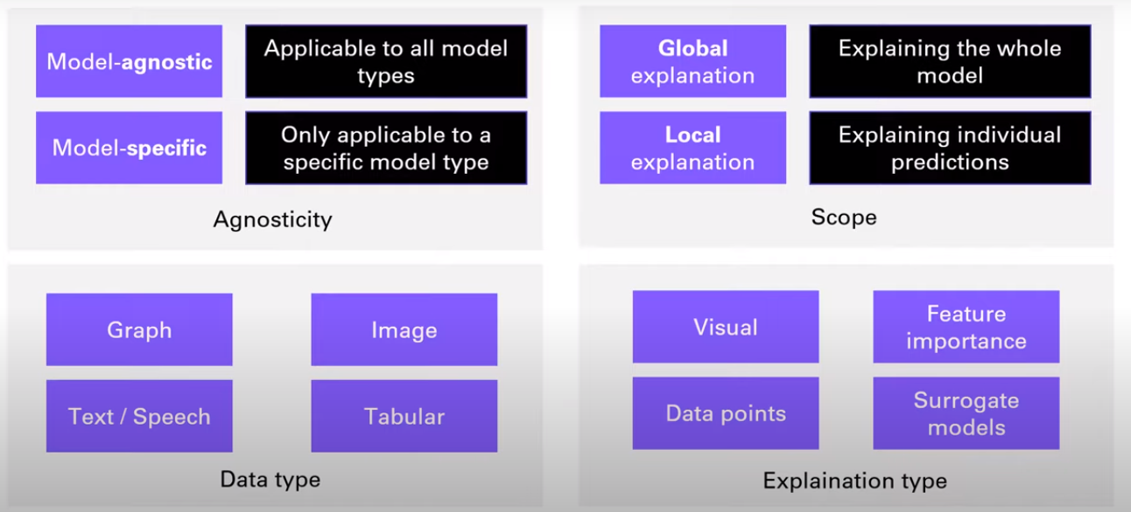
Categorization of AI

Slide 8
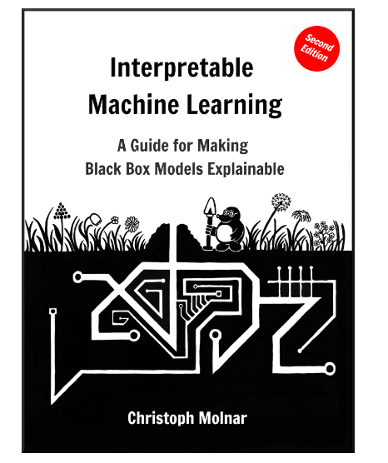
A Good Book
https://christophm.github.io/interpretable-ml-book/

Slide 9
Most Popular XAI Methods
LIME and SHAP are both popular methods for explainable AI (XAI), but they differ in several key ways:
Model-agnostic vs model-specific
Local vs global explanations
Interpretability vs accuracy trade-off
Kernel-based vs game-theoretic approach
Summary
We will cover only SHAP

Slide 10
Model-agnostic vs model-specific
LIME is model-agnostic, meaning it can be used to explain the decisions of any machine learning model, regardless of the algorithm used.
SHAP is a model-specific method that is designed to explain the decisions of tree-based models, such as decision trees, random forests, and gradient boosting machines.

Slide 11
Local vs global explanations
LIME generates local explanations, meaning it explains the decision of a complex model for a specific instance or observation.
SHAP provides global explanations, meaning it explains the overall behavior of the model across all instances.

Slide 12
Interpretability vs accuracy trade-off
LIME sacrifices some accuracy in order to provide more interpretable explanations. It creates a simpler model that may not be as accurate as the complex model but is easier to understand.
SHAP aims to provide accurate explanations without sacrificing model accuracy. It uses a more sophisticated approach to explain the contribution of each feature, but this can be more difficult to understand for non-experts.

Slide 13
Kernel-based vs game-theoretic approach
LIME uses a kernel-based approach to explain the decisions of a complex model. It creates a local, interpretable model that approximates the behavior of the complex model around a specific instance.
SHAP uses a game-theoretic approach to explain the contribution of each feature to the final prediction. It assigns a "credit" score to each feature based on how much it contributes to the prediction.

Slide 14
Summary
LIME and SHAP are both useful methods for XAI, but they differ in their approach to explaining the decisions of complex machine learning models.
LIME is model-agnostic and provides local, interpretable explanations, while SHAP is model-specific and provides global explanations using a game-theoretic approach.

Slide 15
SHapley Additive exPlanations (SHAP)
It is based on the concept of Shapley values. Here is a timeline for the SHAP method:
1953: Introduction of Shapley values by Lloyd Shapley for game theory
2010: First use of Shapley values for explaining machine learning predictions by Strumbelj and Kononenko
2017: SHAP paper + Python package by Lundberg

Slide 16
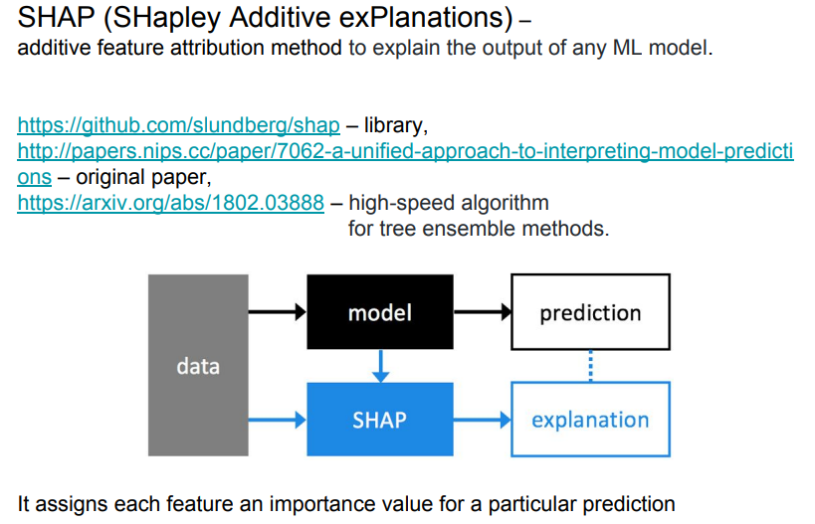

Slide 17
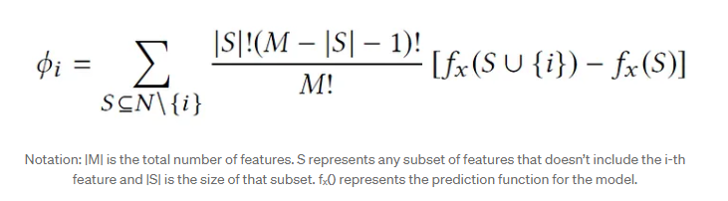
How Shapely values are calculated

Slide 18
Details
The above formula is a summation over all possible subsets (S) of feature values excluding the i-th feature value.
Here, |S|! represents the number of permutations of feature values that appear before i-th feature value.
Similarly, (|M|-|S|-1 )! represents the number of permutations of feature values that appear after the i-th feature value.
The difference term in the above equation is the marginal contribution of adding i-th feature value to S.
Also note that the above equation requires us to compute the model’s prediction for any subset of features, which may not be feasible for an ML model.

Slide 19
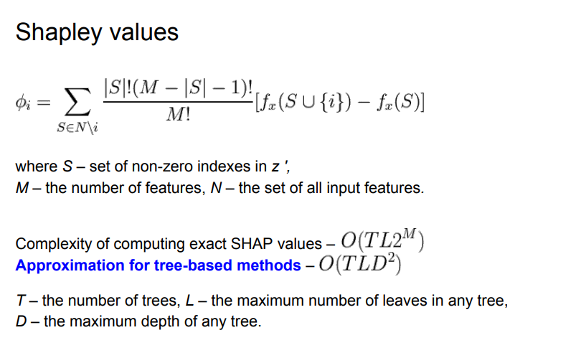
weight
Marginal Contribution of feature i to coalition S

Slide 20
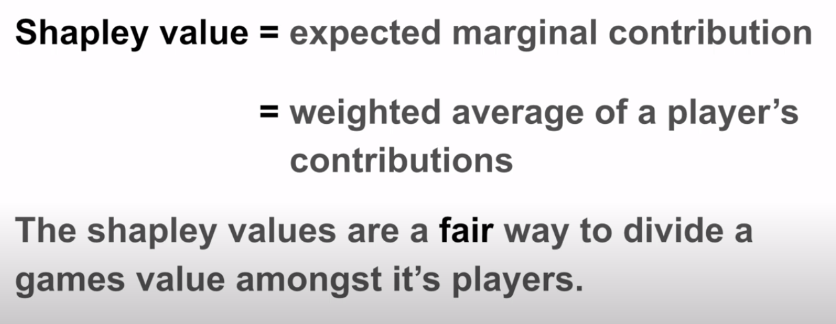

Slide 21
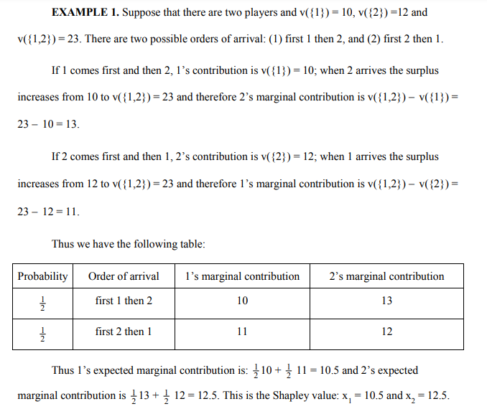

Slide 22
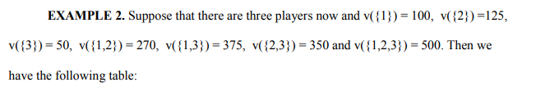
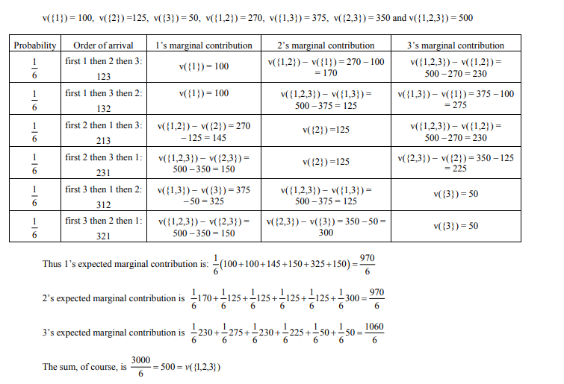

Slide 23
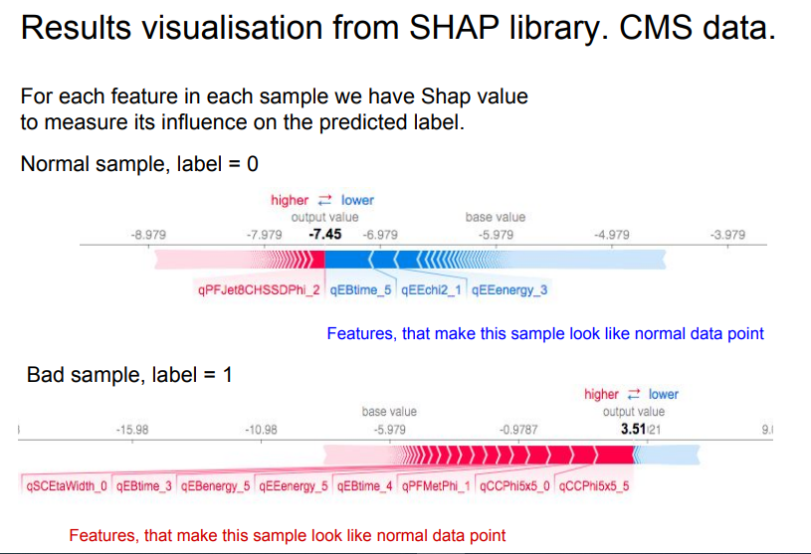

Slide 24
